Slide 1
UNIVERSITY ADMIT ELIGIBILITY PREDICTOR
NALAYATHIRAN PROJECT
TEAM: 04
PROJECT STUDENTS:
Sharanesh S - 1904046
Shyamsunder R - 1904049
Srivathsan P - 1904052
Sukumar A S - 1904057

Slide 2
OBJECTIVE
The main objective of the project is to create and train a model to predict a student’s chance of getting into a particular university based on the parameters such as decent score, a SOP (statement of purpose), or a letter of reference, and other things.

Slide 3
INTRODUCTION
University education is becoming a critical pillar of social and economic life in the twenty-first century. One of the common hurdles among students is that they often get stranded about what’s next.
They are often worried about their chances of admission into University. The existing solutions rather focus on the universities, what they offer and students can go through all they want about the universities.
But predicting university entrance, on the other hand, might be extremely challenging because students are unaware of the admission standards. So, to make easy on hands our proposed model helps students to get an idea about it.

Slide 4
NEED FOR THE PROJECT
University Admission Eligibility Predictor using Machine Learning techniques, would be helpful in finding the right university where a student might be eligible to get into. The predicted output gives them a fair idea about their admission chances in a particular university.
This analysis should help students who are currently preparing or needed for preparing to get a better idea.

Slide 5
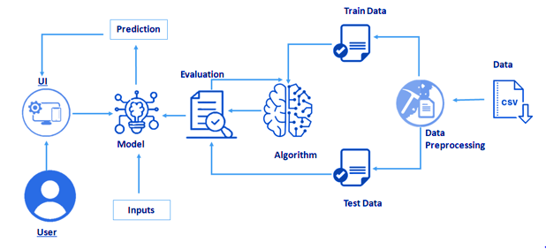
PROPOSED SYSTEM MODEL

Slide 6
HARDWARE/ SOFTWARE TOOL USED
SOFTWARE REQUIRED:
IBM Cloud
Python IDLE

